Slide 1

Data Warehousing & Data Mining(CSC496)
By
Mr. Usman Shehzaib
(Assistant Professor)
Department of Computer Science
CUI Lahore Campus

Slide 2
Course Objectives
This course introduces the concept of data warehousing that can help in facilitating effective and timely decision making in any organization. Moreover it guides about data mining techniques that can help in identifying patterns in data.

Slide 3
Course Material
[1] Paulraj, P.: “Data Warehousing Fundamentals”, John Wiley & Sons Inc., NY.
[2] Han, J. and Kamber, M. (2012) Data Mining Concepts and Techniques, 3rd Edition, Morgan Kaufmann.
[3] Ricardo, C. M.: “Database Systems: Principles Design and Implementation”, Macmillan Coll Div.
[4] “The Data Warehouse Tool Kit” by Ralph Kimball

Slide 4
Course Introduction
Information Sources
Data Warehouse
Server
(Tier 1)
OLAP Servers
(Tier 2)
Clients
(Tier 3)
e.g., MOLAP
Semistructured
Sources
Analysis
Data
Warehouse
serve
extract
transform
load
refresh
etc.
Query/Reporting
serve
e.g., ROLAP
Operational
DB’s
serve
Data Mining
Data Marts

Slide 5
Operational Sources (OLTP’s)
Operational computer systems did provide information to run day-to-day operations, and answer’s daily questions
Also called online transactional processing system (OLTP)
Data is read or manipulated with each transaction
Transactions/queries are simple, and easy to write
Usually for middle management
Examples
Sales systems
Hotel reservation systems
HRM Applications
Payroll
Etc.

Slide 6
Typical decision queries
Data set are mounting everywhere, but not useful for decision support
Strategic Information = Enterprise wide essential data
People need timely strategic information to take appropriate decisions to get competitive advantages
Decision-making require complex questions from integrated data.
Decision makers want to know:
Where to build new oil warehouse?
Which market they should strengthen?
Which customer groups are most profitable?
How much is the total sale by month/ year/ quarter for each offices?
Is there any relation between promotion campaigns and sales growth?
Can OLTP answer all such questions, ☹ efficiently?

Slide 7
Characteristics of strategic information
Integrated
Must have a single, enterprise-wide view
Data Integrity
Information must be accurate and must conform to business rules
Accessible
Easily accessible with intuitive access paths and responsive for analysis
Credible
Every business factor must have one and only one value
Timely
Information must be available within the stipulated time frame

Slide 8
Information Crisis
It means “lack of information”
Two major reasons
Availability of huge data on disparate platforms and in diverse forms, Moreover, the data must be available in a format that helps in spotting trends and pattern in the data.
The incapability of information technology or information systems to turn this data in usable form

Slide 9
History of Decision Support Systems (DSS)
Ad-Hoc Reports: IT created small program for each required report.
Special Extract Programs: Collection of programs written for anticipated reports.
Small Applications: Small programs with the option of taking parameters as input from the user
IT centers: Special places where users can go for asking pre-generated reports. IT people present there helped users to obtain information.
Decision Support Systems: Much sophisticated systems, menu driven, online processing, printable reports, but were made using extracted files.
Executive Information Systems: Simple reports on user desktop, but again preprogramed reports.

Slide 10
Failure of old DSS (cont.)
Inability to provide strategic information
IT receive too many ad hoc requests, so large over load
Requests are not only numerous, they change overtime
For more understanding more reports
Users are in spiral of reports
Users have to depend on IT for information
Can't provide enough performance, slow
Strategic information have to be flexible (not predefined strictly) and conductive (could be guided) for analysis

Slide 11
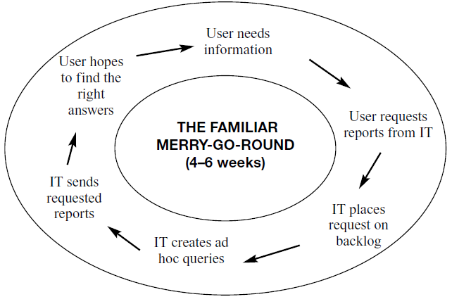
Failure of old DSS (Cont.)
A typical spiral of user needs and IT efforts

Slide 12
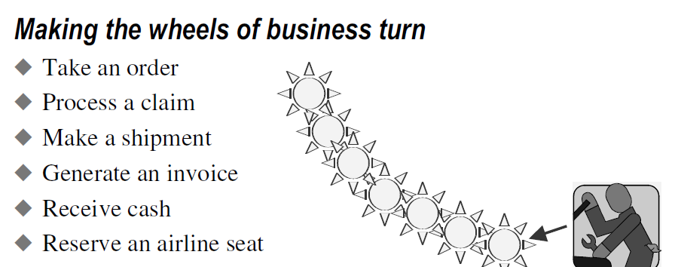
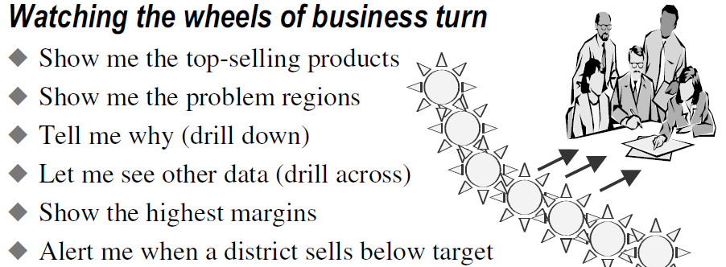
OLTP vs. DSS
OLTP (Get the data in)
DSS (Get the information out)

Slide 13
OLTP vs. DSS (cont.)
Trait | OLTP | DSS
User | Middle management | Executives, decision-makers
Function | For day-to-day operations | For analysis & decision support
DB (modeling) | E-R based, after normalization | Star oriented schemas
Data | Current, Isolated | Archived, derived, summarized
Unit of work | Transactions | Complex query
Access, type | DML, read | Read
Access frequency | Very high | Medium to Low
Records accessed | Tens to Hundreds | Thousands to Millions
Quantity of users | Thousands | Very small amount
Usage | Predictable, repetitive | Ad hoc, random, heuristic based
DB size | 100 MB-GB | 100GB-TB
Response time | Sub-seconds | Up-to min.s

Slide 14
Expectations of new soln.
DB designed for analytical tasks
Data from multiple applications
Easy to use
Ability of what-if analysis
Read-intensive data usage
Direct interaction with system, without IT assistance
Periodical updating contents & stable
Current & historical data
Ability for users to initiate reports

Slide 15
DW meets expectations
Provides enterprise view
Current & historical data available
Decision-transaction possible without affecting operational source
Reliable source of information
Ability for users to initiate reports
Acts as a data source for all analytical applications

Slide 16
Definition of DW
Inmon defined
“A DW is a subject-oriented, integrated, non-volatile, time-variant collection of data in favor of decision-making”.
Kelly said
“Separate available, integrated, time-stamped, subject-oriented, non-volatile, accessible”
Four properties of DW

Slide 17
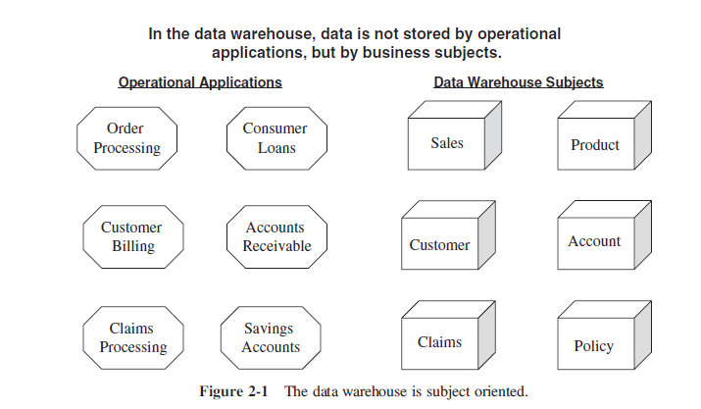
Subject-oriented
In operational sources data is organized by applications, or business processes.
In DW subject is the organization method
Subjects vary with enterprise
These are critical factors, that affect performance
Example of Manufacturing Company
Sales
Shipment
Inventory etc

Slide 18
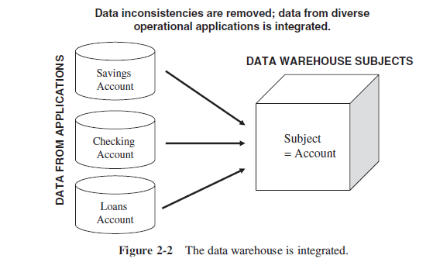
Integrated Data
Data comes from several applications
Problems of integration comes into play
File layout, encoding, field names, schema, data heterogeneity are the issues
Bank example, variance: naming convention, attributes for data item, account no, account type, size, currency
In addition to internal, external data sources
External companies data sharing
Websites
Others
Removal of inconsistency
So process of extraction, transformation & loading

Slide 19
Time variant
Operational data has current values
Comparative analysis is one of the best techniques for business performance evaluation
Time is critical factor for comparative analysis
Every data structure in DW contains time element
In order to promote product in certain area, analyst has to know about current and historical values
The advantages are
Allows for analysis of the past
Relates information to the present
Enables forecasts for the future

Slide 20
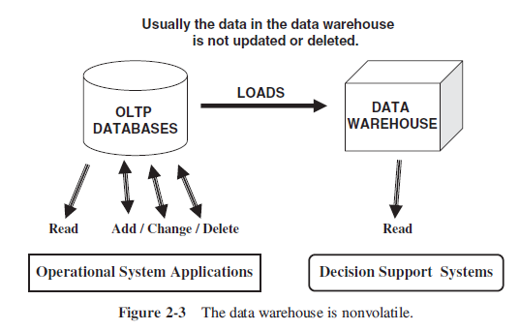
Non-volatile
Data from operational systems are moved into DW after specific intervals
Data is persistent/ not removed i.e. non volatile
Every business transaction don’t update in DW
Data from DW is not deleted
Data is neither changed by individual transactions

Slide 21
Architecture of DW
Information Sources
Data Warehouse
Server
(Tier 1)
OLAP Servers
(Tier 2)
Clients
(Tier 3)
e.g., MOLAP
Analysis
Semistructured
Sources
Data
Warehouse
serve
extract
transform
load
refresh
Query/Reporting
serve
e.g., ROLAP
Operational
DB’s
serve
Data Mining
Staging area
Data Marts

Slide 22
Components
Major components
Source data component
Data staging component
Data storage component
Information delivery component
Metadata component
Management and control component

Slide 23
1. Source Data Component
Source data can be grouped into 4 components
Production data
Comes from operational systems of enterprise
Some segments are selected from it depending on requirements
Narrow scope, e.g. order details
Internal data
Private datasheet, documents, customer profiles etc.
E.g. Customer profiles for specific offering
Special strategies to transform ‘it’ to DW (text document)
Archived data
Old data is archived in operational systems using maybe separate archival database that might be still online, maybe stored in flat files and ever more old data on tapes.
DW have snapshots of historical data
External data
Executives depend upon external sources
E.g. market data of competitors, market indicators.
For example, car rental business would like to have information about the production schedule of car making companies to make strategic decisions
But integration require conformance with your data

Slide 24
Architecture of DW
Information Sources
Data Warehouse
Server
(Tier 1)
OLAP Servers
(Tier 2)
Clients
(Tier 3)
e.g., MOLAP
Analysis
Semistructured
Sources
Data
Warehouse
serve
extract
transform
load
refresh
Query/Reporting
serve
e.g., ROLAP
Operational
DB’s
serve
Data Mining
Staging area
Data Marts

Slide 25
2. Data Staging Component
After data is extracted, data is to be prepared
Data extracted from sources needs to be changed, converted and made ready in suitable format
Three major functions to make data ready
Extract
Transform
Load

Slide 26
Architecture of DW
Information Sources
Data Warehouse
Server
(Tier 1)
OLAP Servers
(Tier 2)
Clients
(Tier 3)
e.g., MOLAP
Analysis
Semistructured
Sources
Data
Warehouse
serve
extract
transform
load
refresh
Query/Reporting
serve
e.g., ROLAP
Operational
DB’s
serve
Data Mining
Staging area
Data Marts

Slide 27
3. Data Storage Component
Separate repository
Data structured for efficient processing
Redundancy is increased
Updated after specific periods
Only read-only

Slide 28
Architecture of DW
Information Sources
Data Warehouse
Server
(Tier 1)
OLAP Servers
(Tier 2)
Clients
(Tier 3)
e.g., MOLAP
Analysis
Semistructured
Sources
Data
Warehouse
serve
extract
transform
load
refresh
Query/Reporting
serve
e.g., ROLAP
Operational
DB’s
serve
Data Mining
Staging area
Data Marts

Slide 29
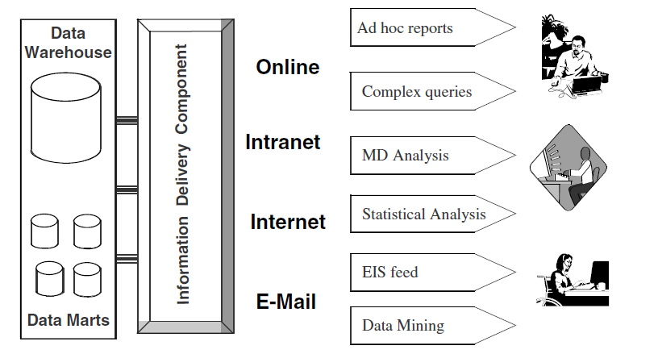
4. Information Delivery Component
Depending on the type of users, different methods and means of information delivery are used are used.

Slide 30
Meta-data component
It is kind of information about the data in the data warehouse
Three kinds of meta-data
Operational: Contains information about the mappings between source systems and data warehouse, e.g., field length, data types
Extraction and Transformation meta-data: For example, extraction frequencies, and extraction methods, and data transformations
End User meta-data: Support users to navigate information using their own terminologies

Slide 31
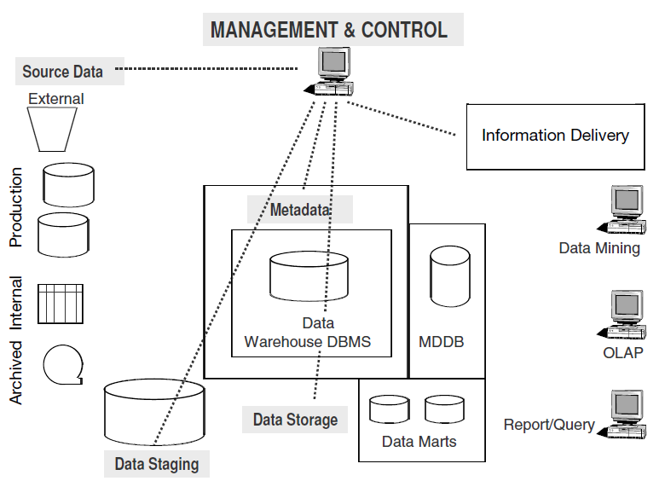
Management and Control Component
It is concerned to coordinate all activities and components involved in data warehouse environment. Usually part of data warehouse DBMS.

Slide 32
Difference between Data Warehouse and Data Marts
Sometimes called synonymously, however, strictly speaking there is a difference between them on the basis of their scale
Data warehouse is enterprise wide.
Data marts are local or at departmental level or targeted for particular group of users.
The main topic of discussion is whether to make data warehouse (top-down approach) first or data marts (bottom-up approach). Both approaches have their advantages and disadvantages.

Slide 33
Top-down approach
Advantages:
Single enterprise wide integrated data
Disadvantages:
Takes too longer to build
High chances of failure
Requires experienced professionals
Senior management is not likely to see the results immediately

Slide 34
Bottom-up approach
Advantages
Faster and easier implementations
Faster return on investment and proof of concept
Less risk of failure
Inherently incremental (can prioritize which data mart to build first)
Disadvantages:
Narrow view of data in each data mart
Spread redundancy in data marts
Can cause inconsistent data

Slide 35
Practical approach propose by Ralph Kimball
Compromise between top-down and bottom-up approaches
First define the requirements of the enterprise
Design the architecture of the whole warehouse
Identify data content for each data mart
Start implementing data marts carefully
Ensure data remain consistent in all data marts in terms of fields length, data types, and precision
The data warehouse thus will be a union of all data marts

